Slide 1
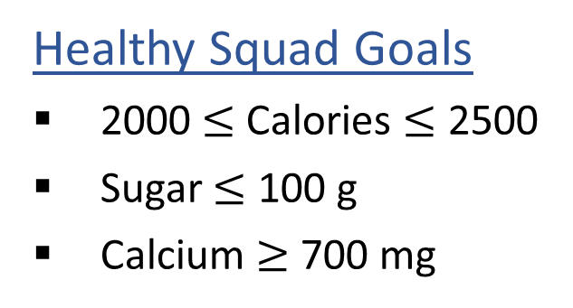
Warm-up: What to eat?
We are trying healthy by finding the optimal amount of food to purchase.
We can choose the amount of stir-fry (ounce) and boba (fluid ounces).
Healthy Squad Goals
2000 $≤$ Calories $≤$ 2500
Sugar $≤$ 100 g
Calcium $≥$ 700 mg
Food | Cost | Calories | Sugar | Calcium
Stir-fry (per oz) | 1 | 100 | 3 | 20
Boba (per fl oz) | 0.5 | 50 | 4 | 70
What is the cheapest way to stay “healthy” with this menu?
How much stir-fry (ounce) and boba (fluid ounces) should we buy?

Slide 2
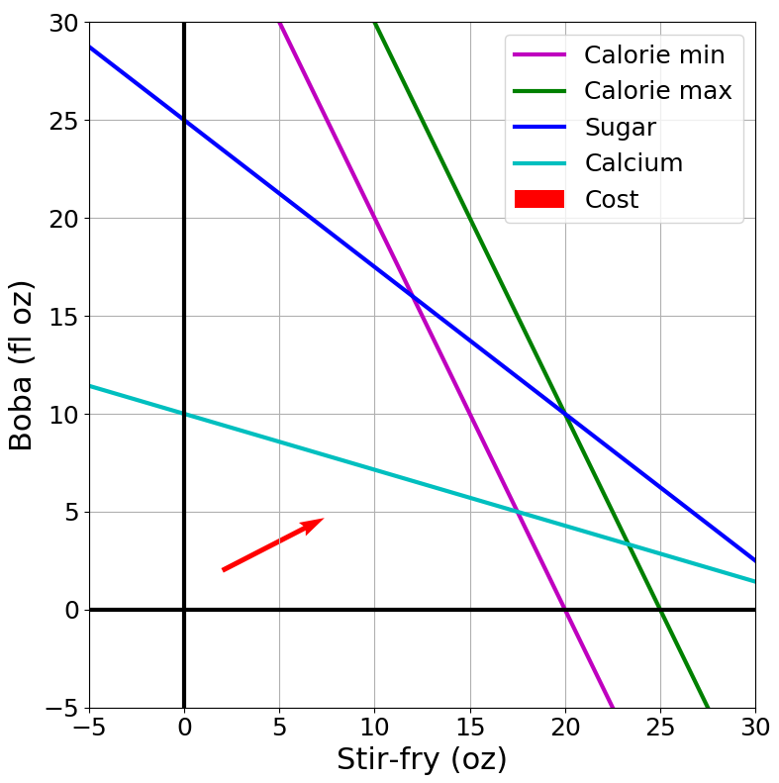

Slide 3
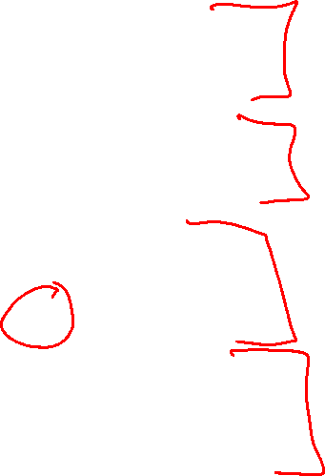
Announcements
Assignments:
HW3 (online)
Due Wed 2/6, 10 pm
P1: Search & Games
Due Thu 2/7, 10 pm
HW4 (written)
Released Wed 2/6
Due Tue 2/12, 10 pm
P2: Optimization
Released later this week
Due Thu 2/21, 10 pm

Slide 4
Announcements
Midterm 1 Exam
Mon 2/18, in class

Slide 5

AAAI Conference
Honolulu, HI

Slide 6
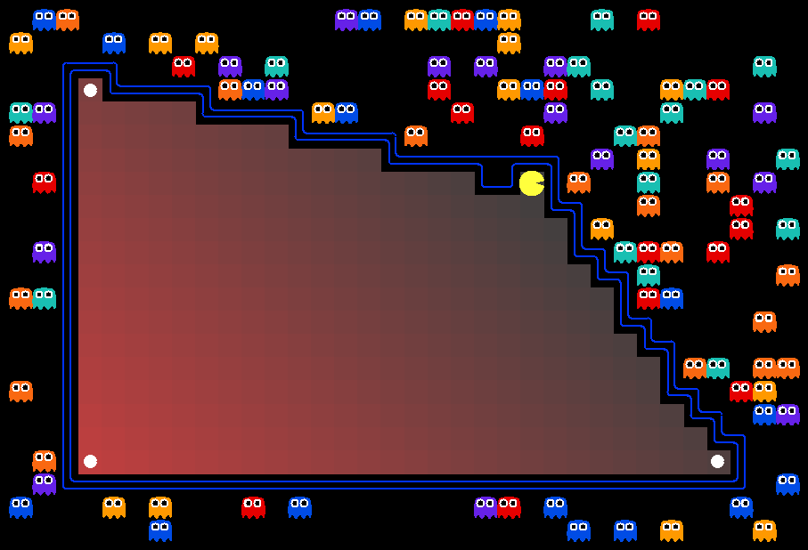
AI: Representation and Problem Solving
Linear Programming
Instructors: Pat Virtue & Stephanie Rosenthal
Slide credits: CMU AI, http://ai.berkeley.edu

Slide 7

Warm-up: What to eat?
We are trying healthy by finding the optimal amount of food to purchase.
We can choose the amount of stir-fry (ounce) and boba (fluid ounces).
Healthy Squad Goals
2000 $≤$ Calories $≤$ 2500
Sugar $≤$ 100 g
Calcium $≥$ 700 mg
Food | Cost | Calories | Sugar | Calcium
Stir-fry (per oz) | 1 | 100 | 3 | 20
Boba (per fl oz) | 0.5 | 50 | 4 | 70
What is the cheapest way to stay “healthy” with this menu?
How much stir-fry (ounce) and boba (fluid ounces) should we buy?

Slide 8
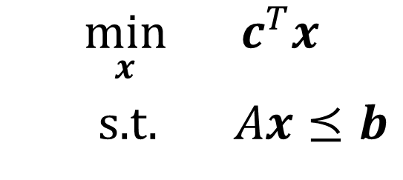
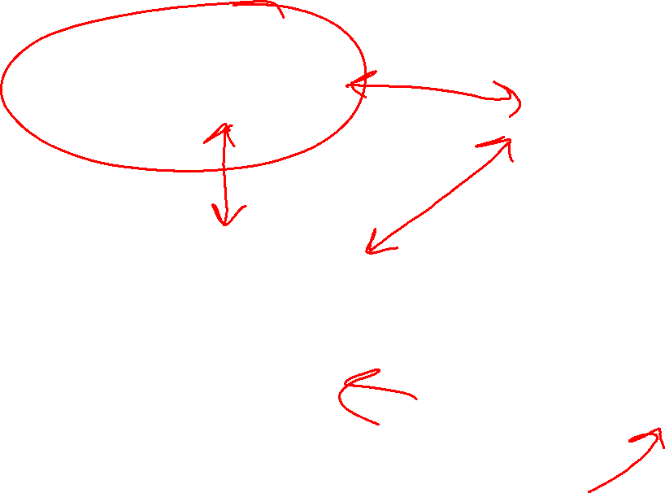
Optimization
Graphical Representation
Problem Description
Optimization Representation
$$\min_{x}{ c^{T}x}$$
s.t. $Ax⪯b$

Slide 9
Warm-up: What to eat?
We are trying healthy by finding the optimal amount of food to purchase.
We can choose the amount of stir-fry (ounce) and boba (fluid ounces).
Healthy Squad Goals
2000 $≤$ Calories $≤$ 2500
Sugar $≤$ 100 g
Calcium $≥$ 700 mg
Food | Cost | Calories | Sugar | Calcium
Stir-fry (per oz) | 1 | 100 | 3 | 20
Boba (per fl oz) | 0.5 | 50 | 4 | 70
What is the cheapest way to stay “healthy” with this menu?
How much stir-fry (ounce) and boba (fluid ounces) should we buy?

Slide 10
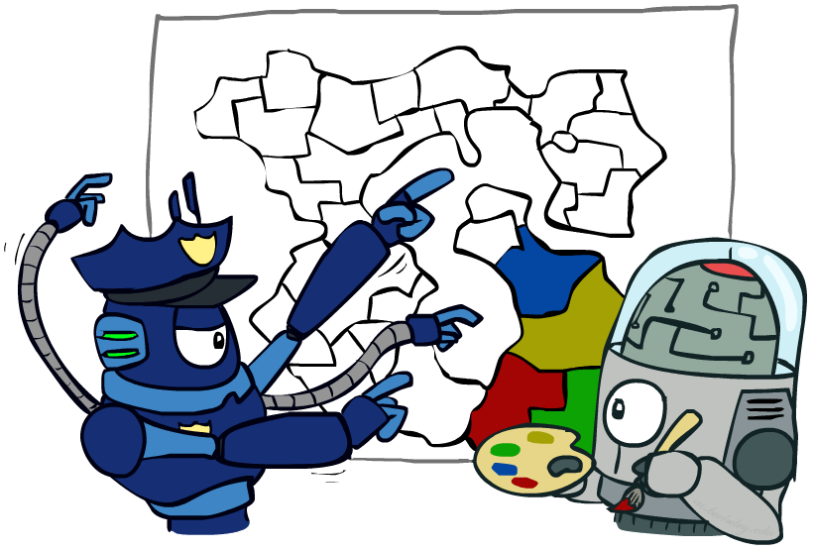
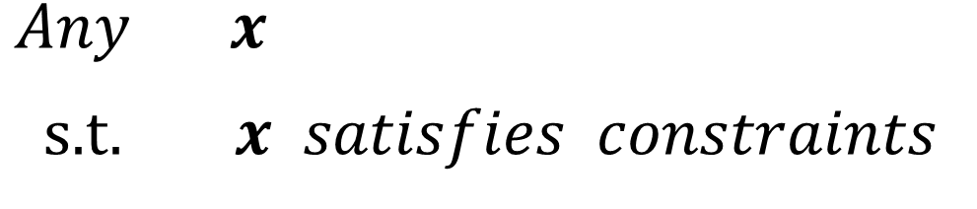
Constraint Satisfaction Problems
Map coloring
$\operatorname{Any}{ x}$
s.t. $x satisfies constraints$

Slide 11
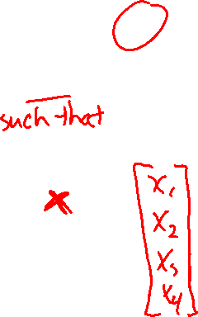
Constraint Satisfaction Problems
Map coloring
$\operatorname{Any}{ x}$
s.t. $x satisfies constraints$
Notation Alert!

Slide 12
What to eat?
We are trying healthy by finding the optimal amount of food to purchase.
We can choose the amount of stir-fry (ounce) and boba (fluid ounces).
Healthy Squad Goals
2000 $≤$ Calories $≤$ 2500
Sugar $≤$ 100 g
Calcium $≥$ 700 mg
Food | Cost | Calories | Sugar | Calcium
Stir-fry (per oz) | 1 | 100 | 3 | 20
Boba (per fl oz) | 0.5 | 50 | 4 | 70
What is the cheapest way to stay “healthy” with this menu?
How much stir-fry (ounce) and boba (fluid ounces) should we buy?

Slide 13

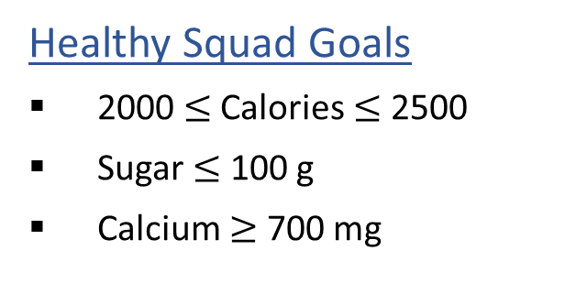
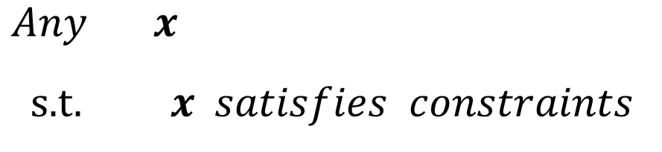

Optimization Formulation
Diet Problem
$\operatorname{Any}{ x}$
s.t. $x satisfies constraints$
Healthy Squad Goals
2000 $≤$ Calories $≤$ 2500
Sugar $≤$ 100 g
Calcium $≥$ 700 mg
Food | Cost | Calories | Sugar | Calcium
Stir-fry (per oz) | 1 | 100 | 3 | 20
Boba (per fl oz) | 0.5 | 50 | 4 | 70
Notation Alert!

Slide 14
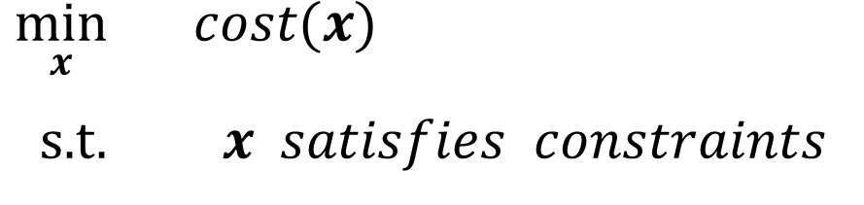
Optimization Formulation
Diet Problem
Objective
$\min_{x}{ cost(x)}$
s.t. $x satisfies constraints$
Healthy Squad Goals
2000 $≤$ Calories $≤$ 2500
Sugar $≤$ 100 g
Calcium $≥$ 700 mg
Food | Cost | Calories | Sugar | Calcium
Stir-fry (per oz) | 1 | 100 | 3 | 20
Boba (per fl oz) | 0.5 | 50 | 4 | 70
Notation Alert!

Slide 15
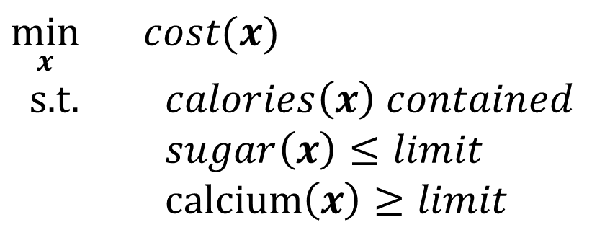

Optimization Formulation
Diet Problem
$\min_{x}{ cost(x)}$
s.t. $calories\left(x\right) contained$
$sugar\left(x\right)≤limit$
calcium$\left(x\right)≥limit$
Healthy Squad Goals
2000 $≤$ Calories $≤$ 2500
Sugar $≤$ 100 g
Calcium $≥$ 700 mg
Food | Cost | Calories | Sugar | Calcium
Stir-fry (per oz) | 1 | 100 | 3 | 20
Boba (per fl oz) | 0.5 | 50 | 4 | 70

Slide 16


Optimization Formulation
Diet Problem
$\min_{x_{1}, { x}_{2}}{ {1 x}_{1}+0.5 x_{2}}$
s.t. $100 x_{1}+50 x_{2}≥2000$
$100 x_{1}+50 x_{2}≤2500$
$3 x_{1}+ 4 x_{2}≤100$
$20 x_{1}+70 x_{2}≥700$
Healthy Squad Goals
2000 $≤$ Calories $≤$ 2500
Sugar $≤$ 100 g
Calcium $≥$ 700 mg
Food | Cost | Calories | Sugar | Calcium
Stir-fry (per oz) | 1 | 100 | 3 | 20
Boba (per fl oz) | 0.5 | 50 | 4 | 70
Notation Alert!

Slide 17
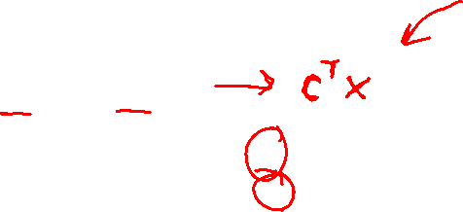


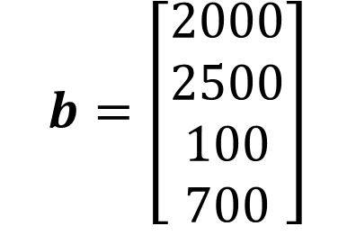
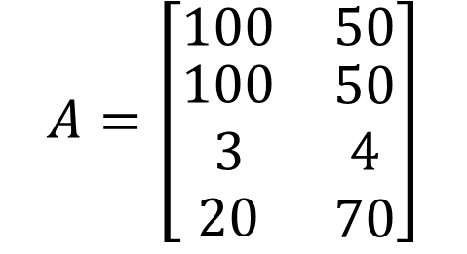
Optimization Formulation
Diet Problem
$\min_{x_{1}, { x}_{2}}{ {c_{1} x}_{1}+c_{2} x_{2}}$
s.t. $a_{1,1} x_{1}+a_{1,2} x_{2}≥b_{1}$
$a_{2,1} x_{1}+a_{2,2} x_{2}≤b_{2}$
$a_{3,1} x_{1}+a_{3,2} x_{2}≤b_{3}$
$a_{4,1} x_{1}+a_{4,2} x_{2}≥b_{4}$
Cost
$$c=\left[\begin{aligned}1 \\ 0.5\end{aligned}\right]$$
Stir-fry
Boba
Limit
$$A=\left[\begin{matrix}100 & 50 \\ \begin{aligned}100 \\ 3 \\ 20\end{aligned} & \begin{aligned}50 \\ 4 \\ 70\end{aligned}\end{matrix}\right]$$
$$b=\left[\begin{aligned}2000 \\ 2500 \\ 100 \\ 700\end{aligned}\right]$$
Calorie min
Calorie max
Sugar
Notation Alert!
Calcium

Slide 18

Optimization Formulation
Diet Problem
$\min_{x}{ c^{T}x}$
s.t. $a_{1,1} x_{1}+a_{1,2} x_{2}≥b_{1}$
$a_{2,1} x_{1}+a_{2,2} x_{2}≤b_{2}$
$a_{3,1} x_{1}+a_{3,2} x_{2}≤b_{3}$
$a_{4,1} x_{1}+a_{4,2} x_{2}≥b_{4}$
Cost
$$c=\left[\begin{aligned}1 \\ 0.5\end{aligned}\right]$$
Stir-fry
Boba
Limit
$$A=\left[\begin{matrix}100 & 50 \\ \begin{aligned}100 \\ 3 \\ 20\end{aligned} & \begin{aligned}50 \\ 4 \\ 70\end{aligned}\end{matrix}\right]$$
$$b=\left[\begin{aligned}2000 \\ 2500 \\ 100 \\ 700\end{aligned}\right]$$
Calorie min
Calorie max
Sugar
Notation Alert!
Calcium

Slide 19


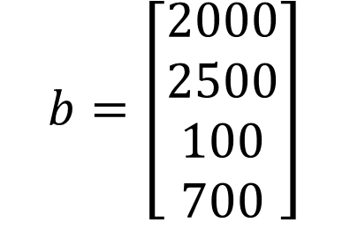
Optimization Formulation
Diet Problem
$\min_{x}{ c^{T}x}$
s.t. $−a_{1,1} x_{1}−a_{1,2} x_{2}≤−b_{1}$
$a_{2,1} x_{1}+a_{2,2} x_{2}≤b_{2}$
$a_{3,1} x_{1}+a_{3,2} x_{2}≤b_{3}$
$−a_{4,1} x_{1}−a_{4,2} x_{2}≤−b_{4}$
Cost
$$c=\left[\begin{aligned}1 \\ 0.5\end{aligned}\right]$$
Stir-fry
Boba
Limit
$$A=\left[\begin{matrix}100 & 50 \\ \begin{aligned}100 \\ 3 \\ 20\end{aligned} & \begin{aligned}50 \\ 4 \\ 70\end{aligned}\end{matrix}\right]$$
$$b=\left[\begin{aligned}2000 \\ 2500 \\ 100 \\ 700\end{aligned}\right]$$
Calorie min
Calorie max
Sugar
Calcium

Slide 20

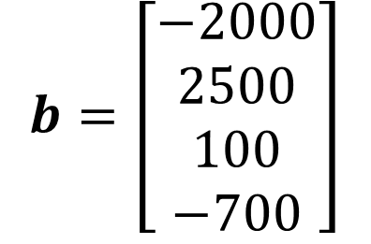
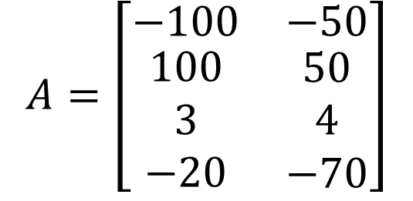
Optimization Formulation
Diet Problem
$\min_{x}{ c^{T}x}$
s.t. $a_{1,1} x_{1}+a_{1,2} x_{2}≤b_{1}$
$a_{2,1} x_{1}+a_{2,2} x_{2}≤b_{2}$
$a_{3,1} x_{1}+a_{3,2} x_{2}≤b_{3}$
$a_{4,1} x_{1}+a_{4,2} x_{2}≤b_{4}$
Cost
$$c=\left[\begin{aligned}1 \\ 0.5\end{aligned}\right]$$
Stir-fry
Boba
Limit
$$A=\left[\begin{matrix}−100 & −50 \\ \begin{aligned}100 \\ 3 \\ −20\end{aligned} & \begin{aligned}50 \\ 4 \\ −70\end{aligned}\end{matrix}\right]$$
$$b=\left[\begin{aligned}−2000 \\ 2500 \\ 100 \\ −700\end{aligned}\right]$$
Calorie min
Calorie max
Sugar
Calcium

Slide 21

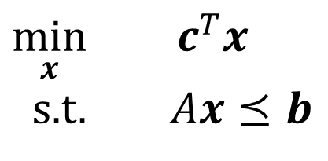
Optimization Formulation
Diet Problem
$\min_{x}{ c^{T}x}$
s.t. $Ax⪯b$
Cost
$$c=\left[\begin{aligned}1 \\ 0.5\end{aligned}\right]$$
Stir-fry
Boba
Limit
$$A=\left[\begin{matrix}−100 & −50 \\ \begin{aligned}100 \\ 3 \\ −20\end{aligned} & \begin{aligned}50 \\ 4 \\ −70\end{aligned}\end{matrix}\right]$$
$$b=\left[\begin{aligned}−2000 \\ 2500 \\ 100 \\ −700\end{aligned}\right]$$
Calorie min
Calorie max
Sugar
Notation Alert!
Calcium

Slide 22

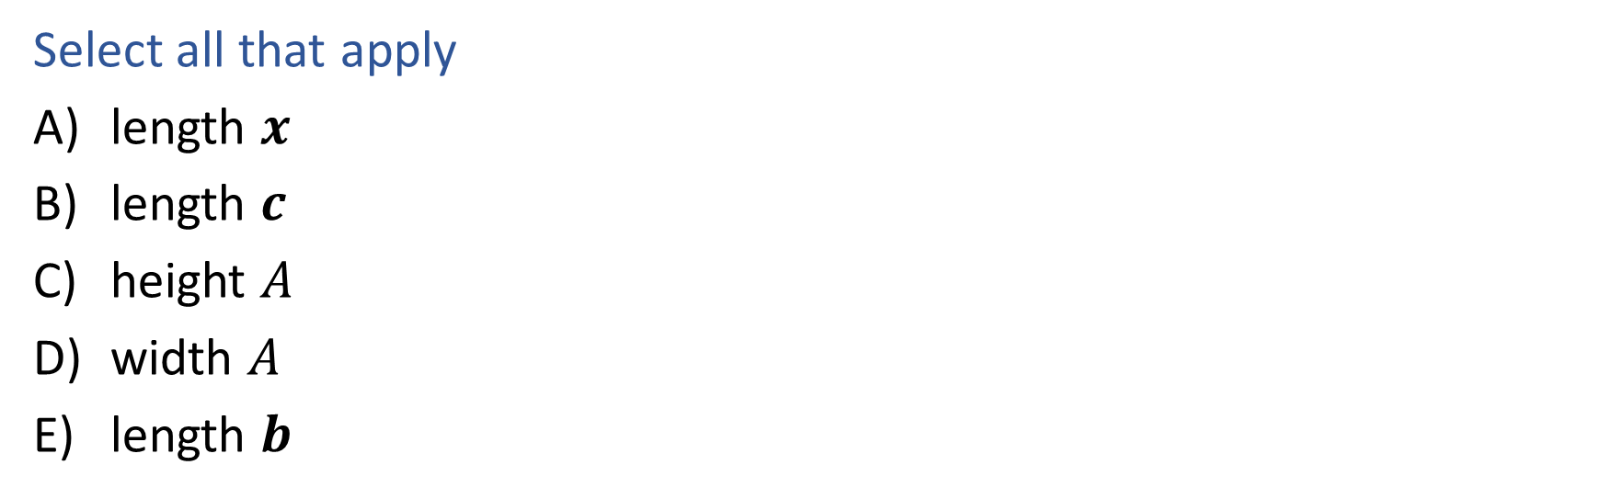
Piazza Poll 1
What has to increase to add more nutrition constraints?
$\min_{x}{ c^{T}x}$
s.t. $Ax⪯b$
Select all that apply
length $x$
length $c$
height $A$
width $A$
length $b$

Slide 23


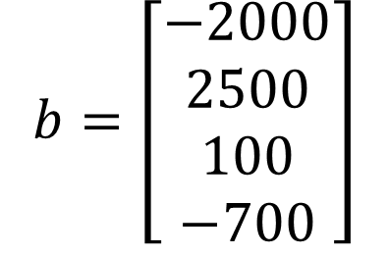
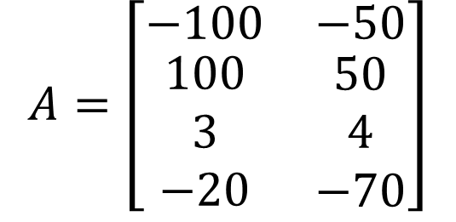
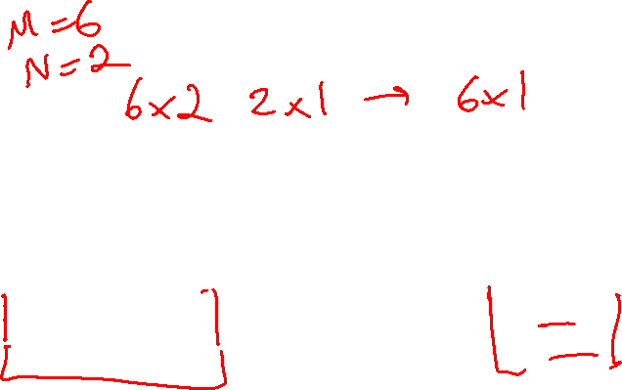
Piazza Poll 1
What has to increase to add more nutrition constraints?
$\min_{x}{ c^{T}x}$
s.t. $Ax⪯b$
$$A=\left[\begin{matrix}−100 & −50 \\ \begin{aligned}100 \\ 3 \\ −20\end{aligned} & \begin{aligned}50 \\ 4 \\ −70\end{aligned}\end{matrix}\right]$$
$$b=\left[\begin{aligned}−2000 \\ 2500 \\ 100 \\ −700\end{aligned}\right]$$
$$x=\left[\begin{aligned}x_{1} \\ x_{2}\end{aligned}\right]$$
$$c=\left[\begin{aligned}1 \\ 0.5\end{aligned}\right]$$

Slide 24

Piazza Poll 2
What has to increase to add more menu items?
$\min_{x}{ c^{T}x}$
s.t. $Ax⪯b$
Select all that apply
length $x$
length $c$
height $A$
width $A$
length $b$

Slide 25
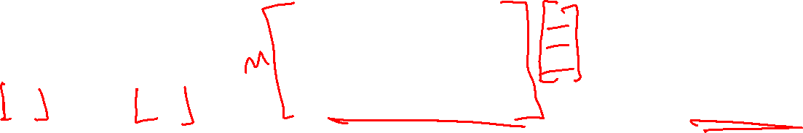
Piazza Poll 2
What has to increase to add more nutrition constraints?
$\min_{x}{ c^{T}x}$
s.t. $Ax⪯b$
$$A=\left[\begin{matrix}−100 & −50 \\ \begin{aligned}100 \\ 3 \\ −20\end{aligned} & \begin{aligned}50 \\ 4 \\ −70\end{aligned}\end{matrix}\right]$$
$$b=\left[\begin{aligned}−2000 \\ 2500 \\ 100 \\ −700\end{aligned}\right]$$
$$x=\left[\begin{aligned}x_{1} \\ x_{2}\end{aligned}\right]$$
$$c=\left[\begin{aligned}1 \\ 0.5\end{aligned}\right]$$

Slide 26
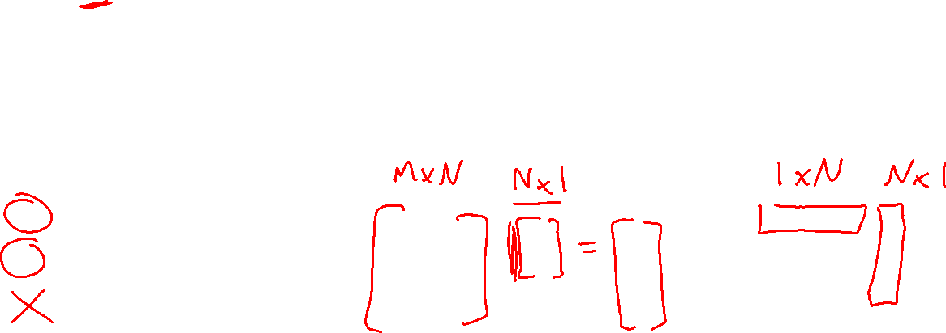
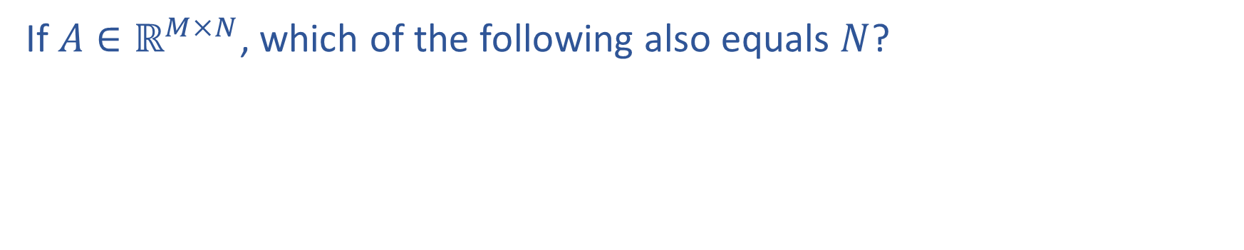
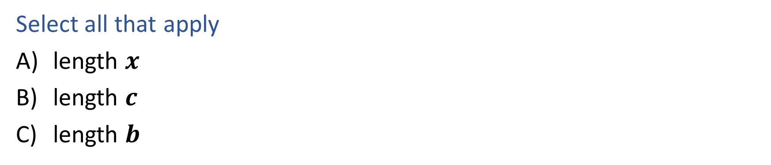
Question
If $A∈ℝ^{M×N}$, which of the following also equals $N$?
$\min_{x}{ c^{T}x}$
s.t. $Ax⪯b$
Select all that apply
length $x$
length $c$
length $b$
Notation Alert!

Slide 27
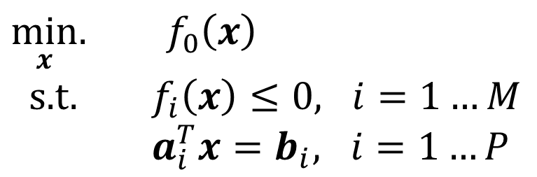
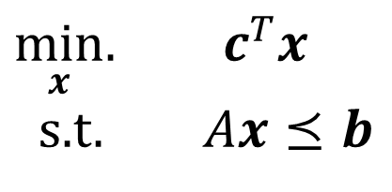
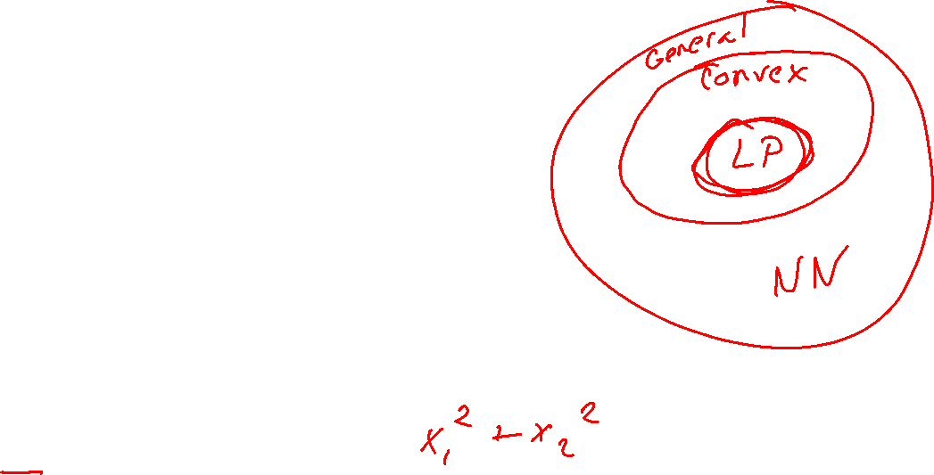
Linear Programming
Linear objective with linear constraints
$\min_{x}.{ c^{T}x}$
s.t. $Ax⪯b$
As opposed to general optimization
$\min_{x}.{ f_{0}\left(x\right)}$
s.t. $f_{i}\left(x\right)≤0, i=1…M$
$a_{i}^{T}x=b_{i}, i=1…P$

Slide 28
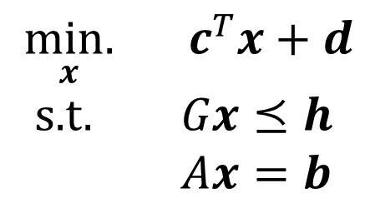
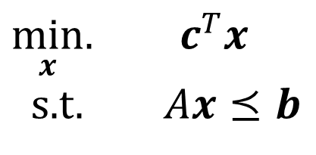
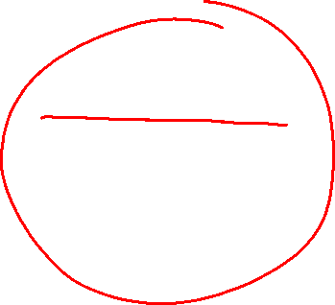
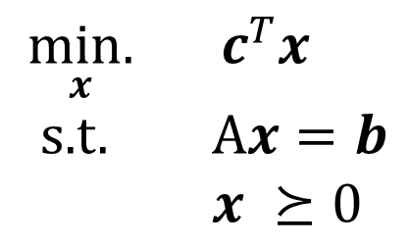
Linear Programming
Different formulations
Inequality form
General form
Standard form
$\min_{x}.{ c^{T}x}$
s.t. $Ax⪯b$
$\underset{x}{min.}{ c^{T}x}+d$
s.t. $Gx⪯h$
$Ax=b$
$\underset{x}{min.}{ c^{T}x}$
s.t. A$x=b$
$x ⪰0$
Important to pay attention to form!

Slide 29
Linear Programming
Different formulations
Inequality form
General form
Standard form
$\min_{x}.{ c^{T}x}$
s.t. $Ax⪯b$
$\underset{x}{min.}{ c^{T}x}+d$
s.t. $Gx⪯h$
$Ax=b$
$\underset{x}{min.}{ c^{T}x}$
s.t. A$x=b$
$x ⪰0$
Can switch between formulations!

Slide 30

Optimization
Graphical Representation
Problem Description
Optimization Representation
$$\min_{x}{ c^{T}x}$$
s.t. $Ax⪯b$

Slide 31

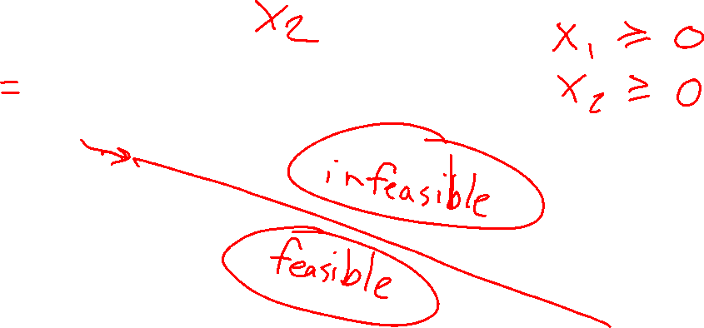
Graphics Representation
Geometry / Algebra I Quiz
What shape does this inequality represent?
$$a_{1} x_{1}+a_{2} x_{2}≤b_{1}$$

Slide 32
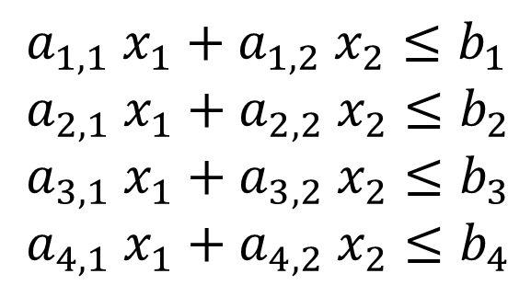

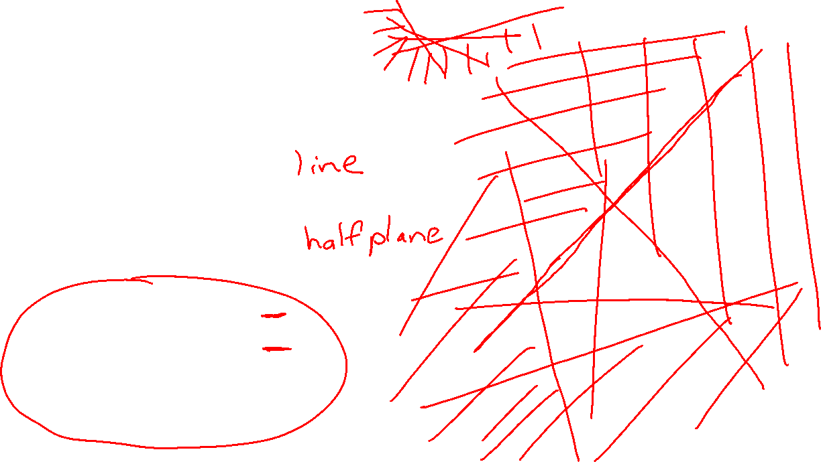

Graphics Representation
Geometry / Algebra I Quiz
What shape does this inequality represent?
$$a_{1} x_{1}+a_{2} x_{2}=b_{1}$$
$$a_{1} x_{1}+a_{2} x_{2}≤b_{1}$$
$a_{1,1} x_{1}+a_{1,2} x_{2}≤b_{1}$
$a_{2,1} x_{1}+a_{2,2} x_{2}≤b_{2}$
$a_{3,1} x_{1}+a_{3,2} x_{2}≤b_{3}$
$a_{4,1} x_{1}+a_{4,2} x_{2}≤b_{4}$

Slide 33







Piazza Poll 3
What is the relationship between the half plane:
$$a_{1} x_{1}+a_{2} x_{2}≤b_{1}$$
and the vector:
$${\left[a_{1}, a_{2}\right]}^{T}$$

Slide 34


Piazza Poll 4
Given the cost vector ${\left[c_{1}, c_{2}\right]}^{T}$ and initial point $x^{(0)}$,
Which unit vector step $△x$ will cause $x^{(1)}=x^{(0)}+△x$
to have the lowest cost $c^{T}x^{(1)}$?
Notation Alert!

Slide 35


Cost Contours
Given the cost vector ${\left[c_{1}, c_{2}\right]}^{T}$ where will
$c^{T}x$ = 0 ?

Slide 36

Cost Contours
Given the cost vector ${\left[c_{1}, c_{2}\right]}^{T}$ where will
$c^{T}x$ = 0 ?
$c^{T}x$ = 1 ?
$c^{T}x$ = 2 ?
$c^{T}x$ = -1 ?
$c^{T}x$ = -2 ?

Slide 37

LP Graphical Representation
Inequality form
$\min_{x}.{ c^{T}x}$
s.t. $Ax⪯b$

Slide 38

LP Graphical Representation
Inequality form, with no constraints
$\min_{x}.{ c^{T}x}$

Slide 39

LP Graphical Representation
Inequality form, with no constraints
$\min_{x}.{ c^{T}x}$
s.t. $a_{1}x_{1}+a_{2}x_{2}≤b$

Slide 40


Piazza Poll 5
True or False: An minimizing LP with exactly on constraint, will always have a minimum objective at $−∞$.
$\min_{x}.{ c^{T}x}$
s.t. $a_{1}x_{1}+a_{2}x_{2}≤b$

Slide 41

Optimization
Graphical Representation
Problem Description
Optimization Representation
$$\min_{x}{ c^{T}x}$$
s.t. $Ax⪯b$

Slide 42
Warm-up: What to eat?
We are trying healthy by finding the optimal amount of food to purchase.
We can choose the amount of stir-fry (ounce) and boba (fluid ounces).
Healthy Squad Goals
2000 $≤$ Calories $≤$ 2500
Sugar $≤$ 100 g
Calcium $≥$ 700 mg
Food | Cost | Calories | Sugar | Calcium
Stir-fry (per oz) | 1 | 100 | 3 | 20
Boba (per fl oz) | 0.5 | 50 | 4 | 70
What is the cheapest way to stay “healthy” with this menu?
How much stir-fry (ounce) and boba (fluid ounces) should we buy?

Slide 43
Optimization Formulation
Diet Problem
$\min_{x}{ c^{T}x}$
s.t. $Ax⪯b$
Cost
$$c=\left[\begin{aligned}1 \\ 0.5\end{aligned}\right]$$
Stir-fry
Boba
Limit
$$A=\left[\begin{matrix}−100 & −50 \\ \begin{aligned}100 \\ 3 \\ −20\end{aligned} & \begin{aligned}50 \\ 4 \\ −70\end{aligned}\end{matrix}\right]$$
$$b=\left[\begin{aligned}−2000 \\ 2500 \\ 100 \\ −700\end{aligned}\right]$$
Calorie min
Calorie max
Sugar
Calcium

Slide 45
Solving an LP
Solutions are at feasible intersections
of constraint boundaries!!

Slide 46
Solving an LP
Solutions are at feasible intersections
of constraint boundaries!!

